Slide 1

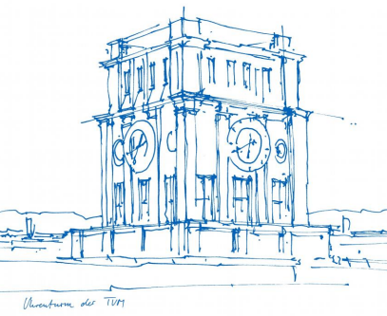
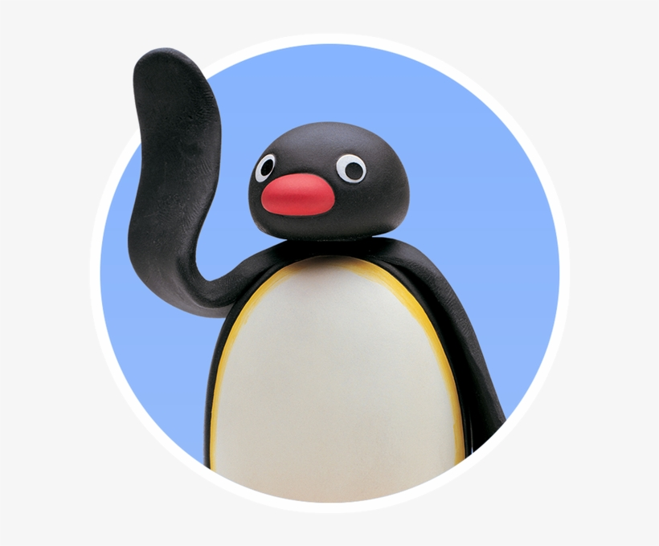
Interaction Prototyping
Lehrstuhl für Ergonomie TUM School of Engineering and Design Technical University of Munich
Milestone 2
The Rolling Penguins
Vincent Brunner Beatrice Seibert Stefano Ferrari
Winter Semester 2021/2022

Slide 2
Lehrstuhl für Ergonomie TUM School of Engineering and Design Technical University of Munich
Content
Use Cases
Usability Requirements
Heuristics Analysis
HiFi Paper Prototype
Reflection on Evaluation Results
Heuristic Evaluation of "We deserve Arrays"
Vincent Brunner | Beatrice Seibert | Stefano Ferrari| Interaction Prototyping| Winter Semester 2021/2022
1

Slide 3
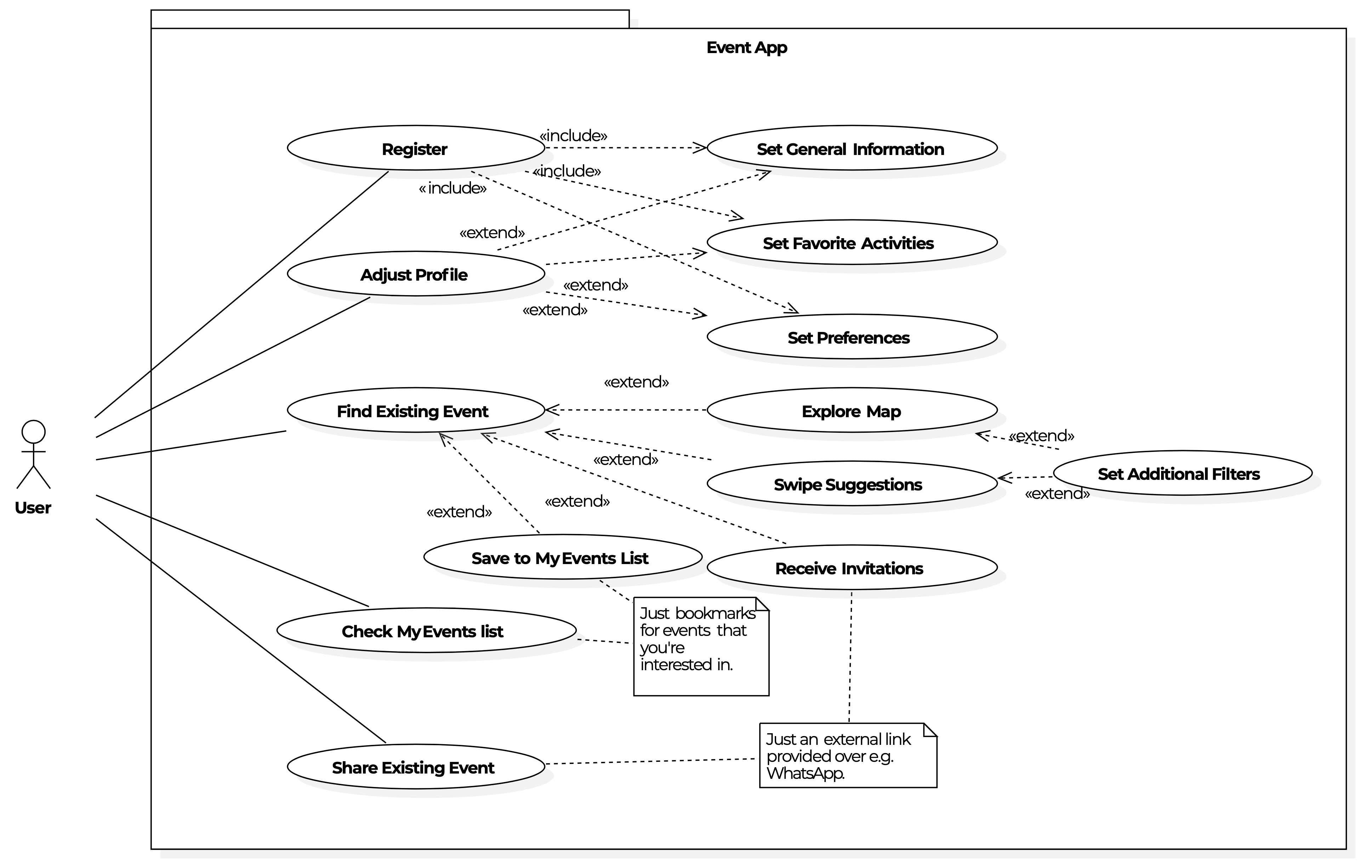
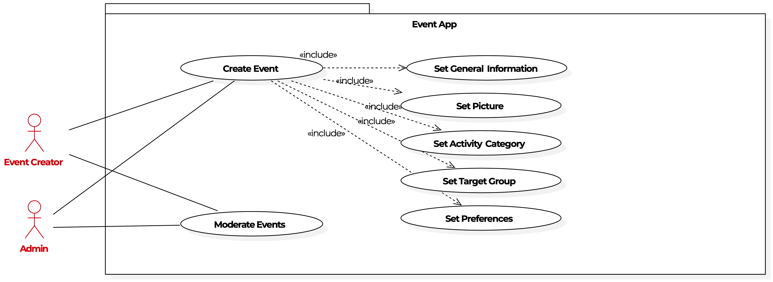
Lehrstuhl für Ergonomie TUM School of Engineering and Design Technical University of Munich
UML Use Cases
Use cases work well for illustrating the functions of a system → Functional Requirements (Russell et al. 2006).
Vincent Brunner | Beatrice Seibert | Stefano Ferrari| Interaction Prototyping| Winter Semester 2021/2022
2

Slide 4
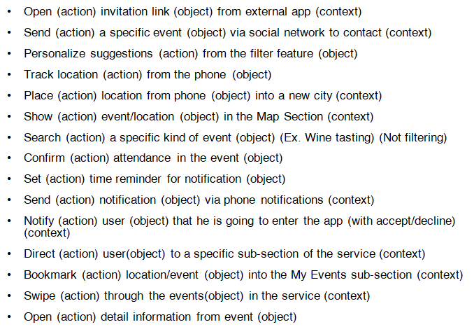

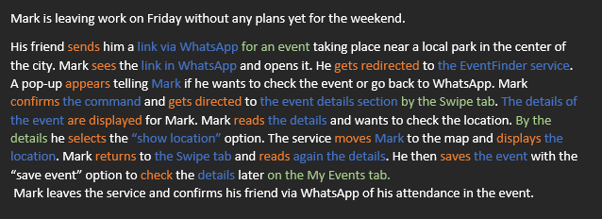
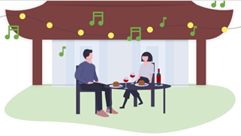
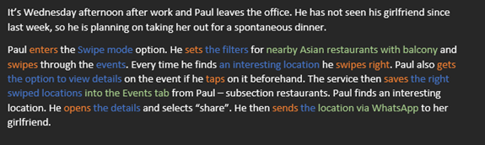
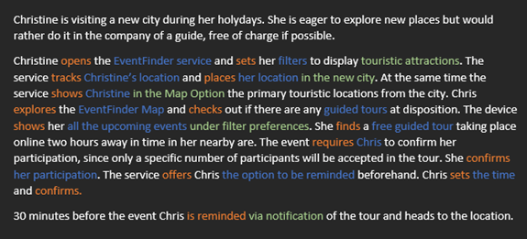
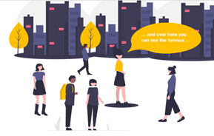
Lehrstuhl für Ergonomie TUM School of Engineering and Design Technical University of Munich
Why?
- To ensure that the service is easy to use.
- To ensure that the service features and functionality have been designed to support users, based on their needs and preferences.
Usability Requirements
Results:
Vincent Brunner | Beatrice Seibert | Stefano Ferrari| Interaction Prototyping| Winter Semester 2021/2022
3

Slide 5
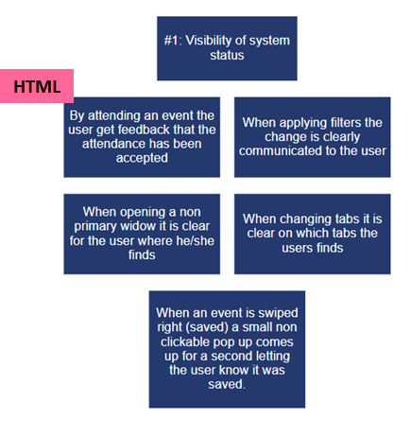
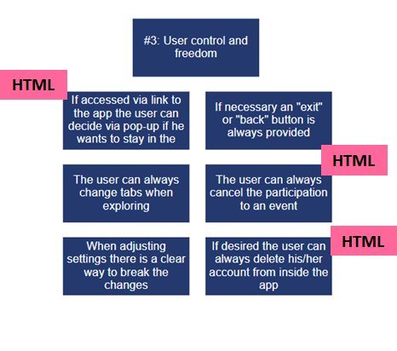
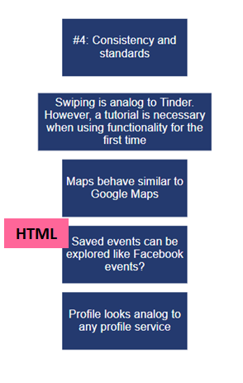
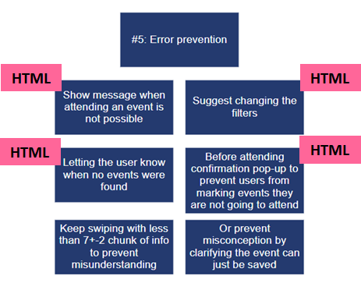
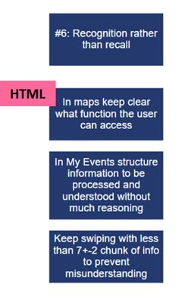
Lehrstuhl für Ergonomie TUM School of Engineering and Design Technical University of Munich
Why?
- Discover usability problems with individual elements and how they impact the overall user experience.
- To further identify and understand problems.
Heuristics Analysis
Results:
Vincent Brunner | Beatrice Seibert | Stefano Ferrari| Interaction Prototyping| Winter Semester 2021/2022
4

Slide 6
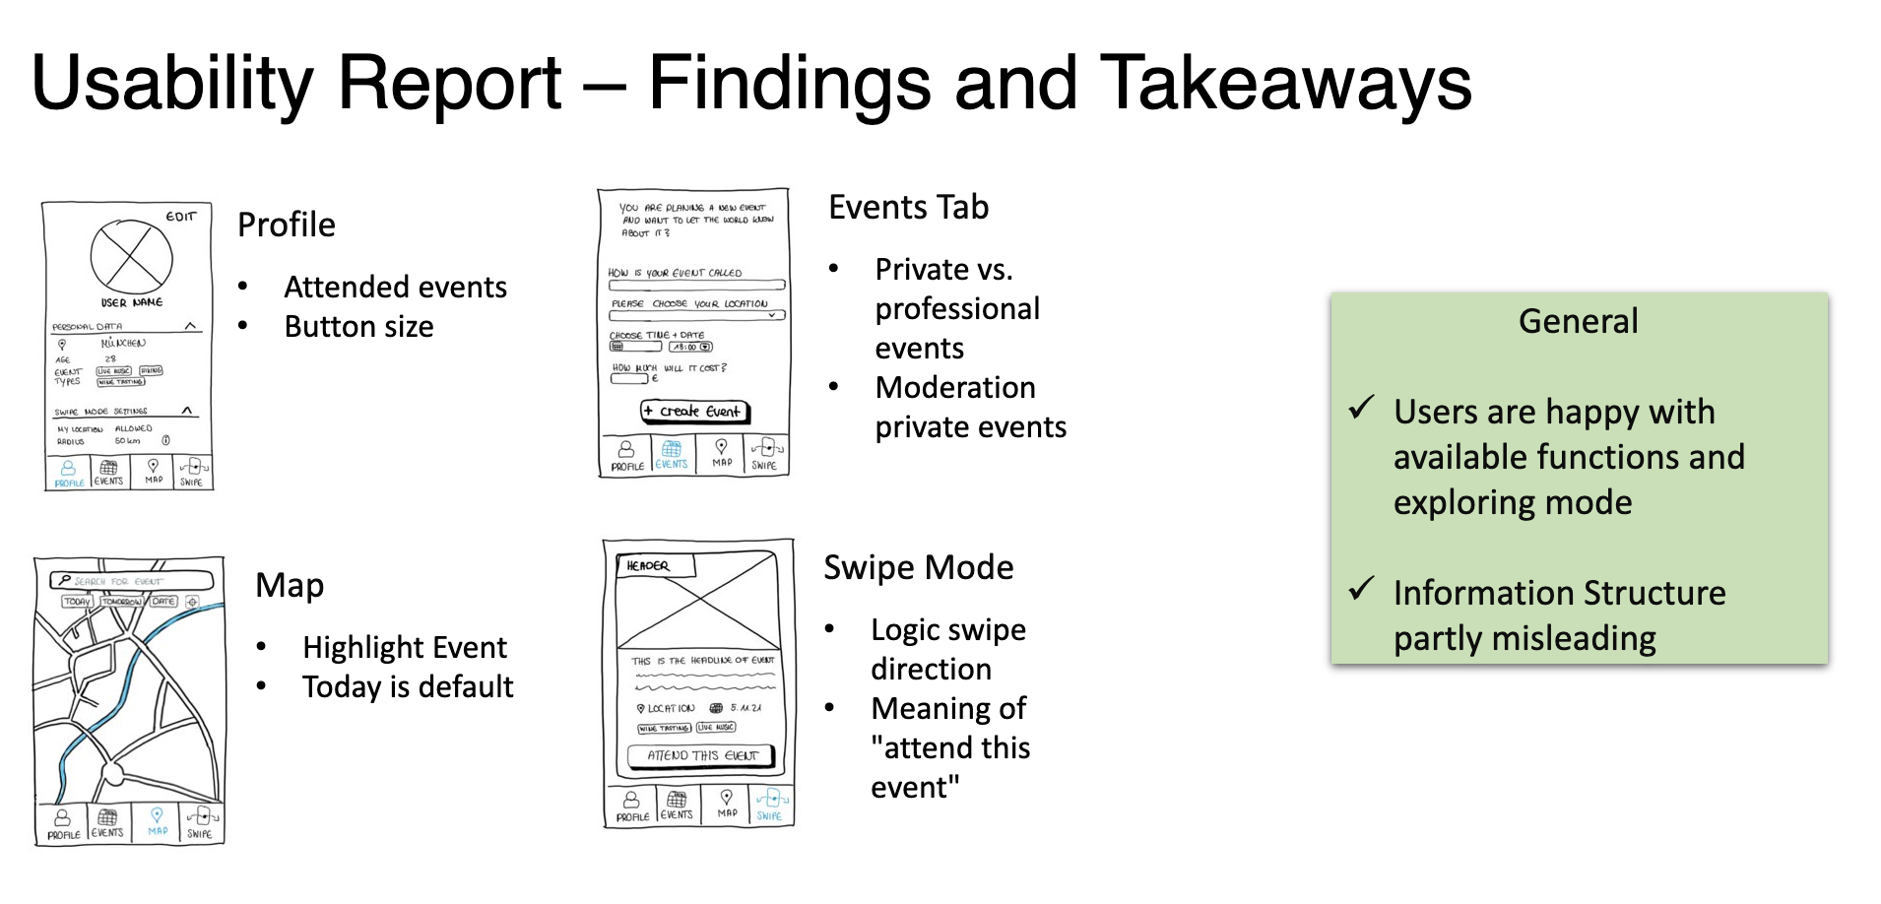
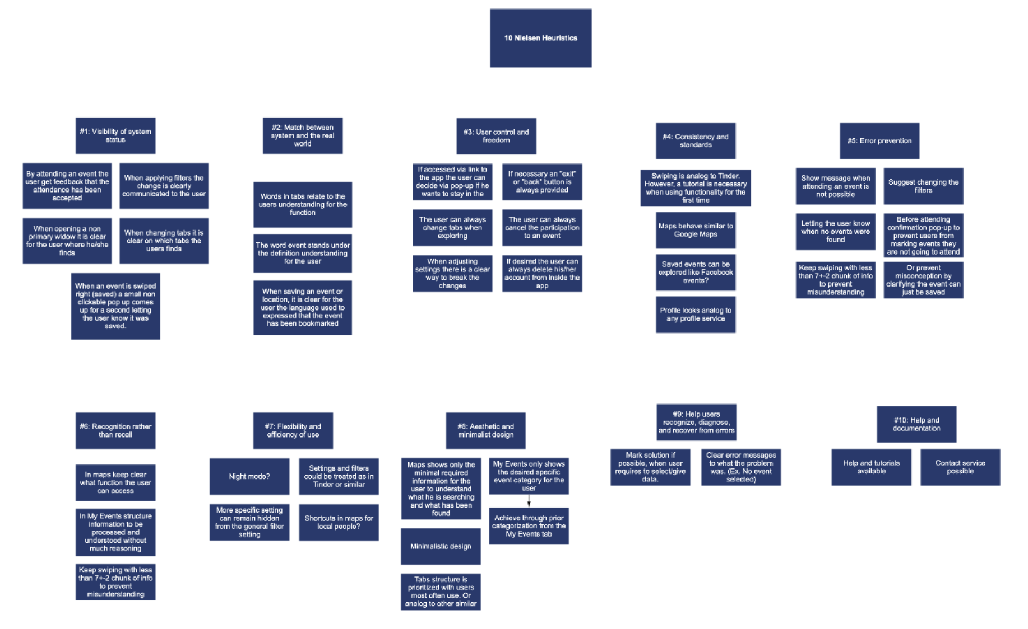
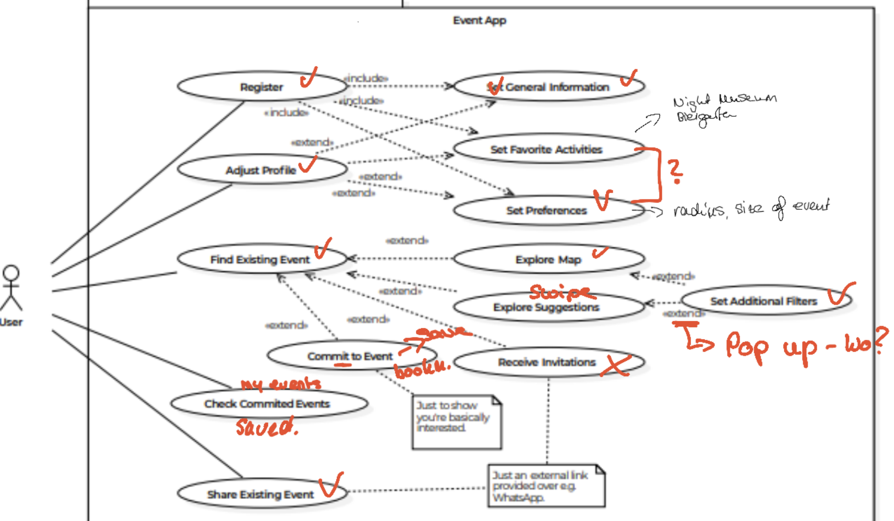
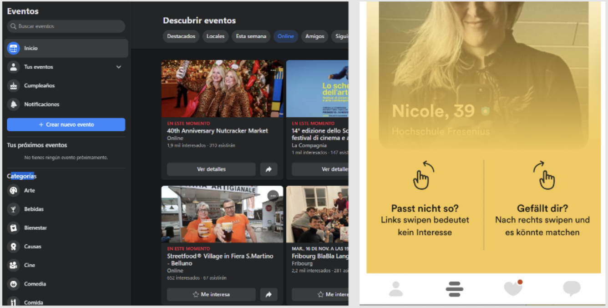
Lehrstuhl für Ergonomie TUM School of Engineering and Design Technical University of Munich
HiFi Paper Prototype
New Prototype based on:
User Feedback Iteration 1
Usability Requirements
Heuristic Evaluation
UML Use Cases
Competitor and similar Apps
Why we consider it?
confusion and expectation of users
how easy the use of the app should be
meets min acceptable experience standards
meets requirements of the App
alternative interface designs
Vincent Brunner | Beatrice Seibert | Stefano Ferrari| Interaction Prototyping| Winter Semester 2021/2022
5

Slide 7
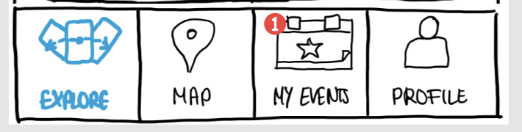
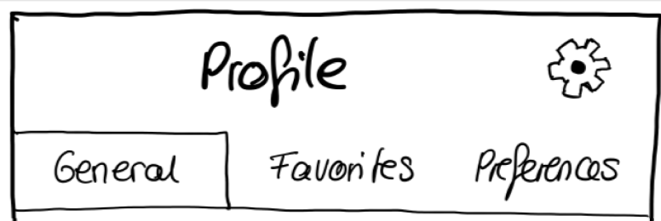
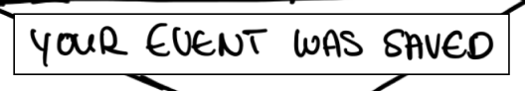
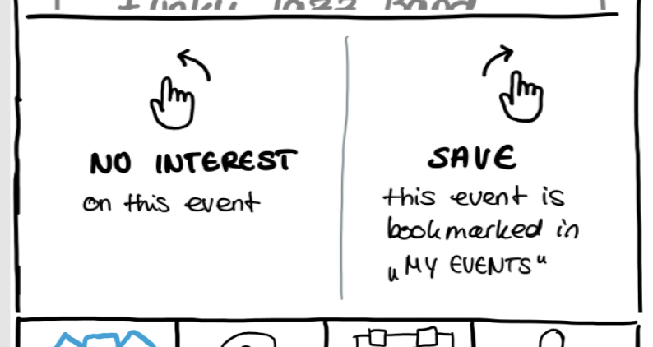
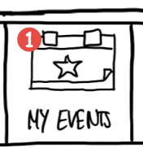
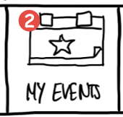

Lehrstuhl für Ergonomie TUM School of Engineering and Design Technical University of Munich
Link to Prototype
HiFi Paper Prototype – What´s New
Information Architecture and Wording
Meeting Requirements
System Feedback
Learnability and Memorability
Error Prevention
Vincent Brunner | Beatrice Seibert | Stefano Ferrari| Interaction Prototyping| Winter Semester 2021/2022
6

Slide 8
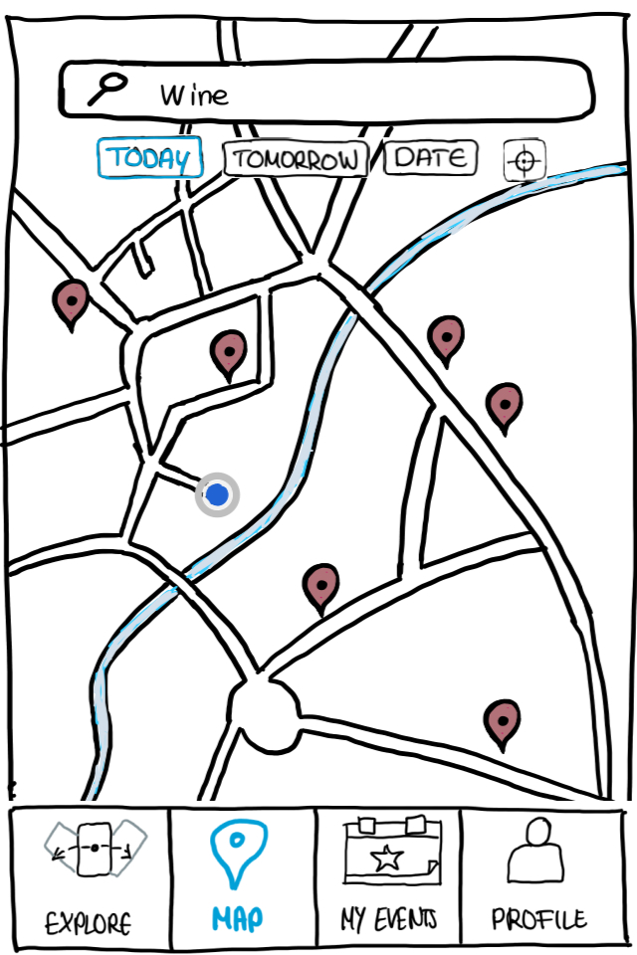
Lehrstuhl für Ergonomie TUM School of Engineering and Design Technical University of Munich
Reflection on Evaluation Results
MAP VIEW
Visibility of system status
Add additional codings for map pins for different kinds of events
Vincent Brunner | Beatrice Seibert | Stefano Ferrari| Interaction Prototyping| Winter Semester 2021/2022
7

Slide 9
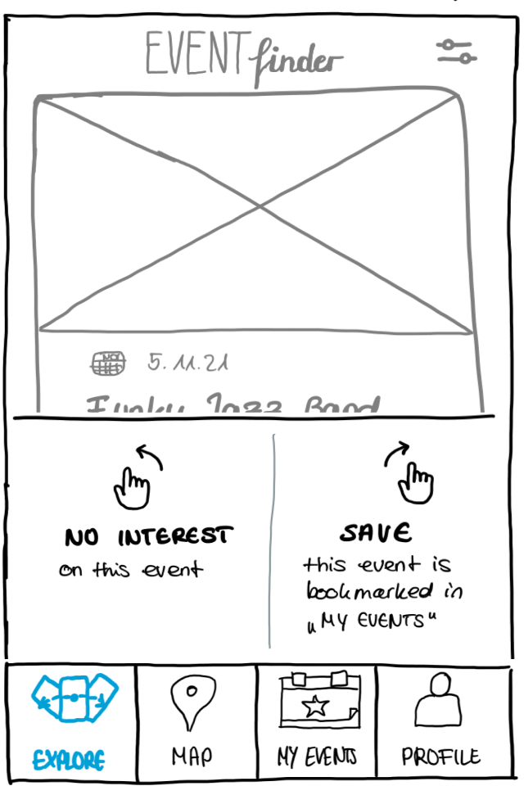
Lehrstuhl für Ergonomie TUM School of Engineering and Design Technical University of Munich
Reflection on Evaluation Results
SWIPE VIEW
Error prevention
Can the user access the swipe explanation again?
Flexibility and efficiency of use
Swiping saves time for finding events and is fun-to-use (gamification)
Help users recognize, diagnose, and recover from errors
Indicate, what happens if the user swipes to left or right (text + icons + color)
SWIPE VIEW
Help and documentation
Provide pull event (explaining swipe feature) after user gave several false inputs, or after certain dwell time
Provide further documentation (FAQ, online help, contact form etc.) → in general
Vincent Brunner | Beatrice Seibert | Stefano Ferrari| Interaction Prototyping| Winter Semester 2021/2022
8

Slide 10
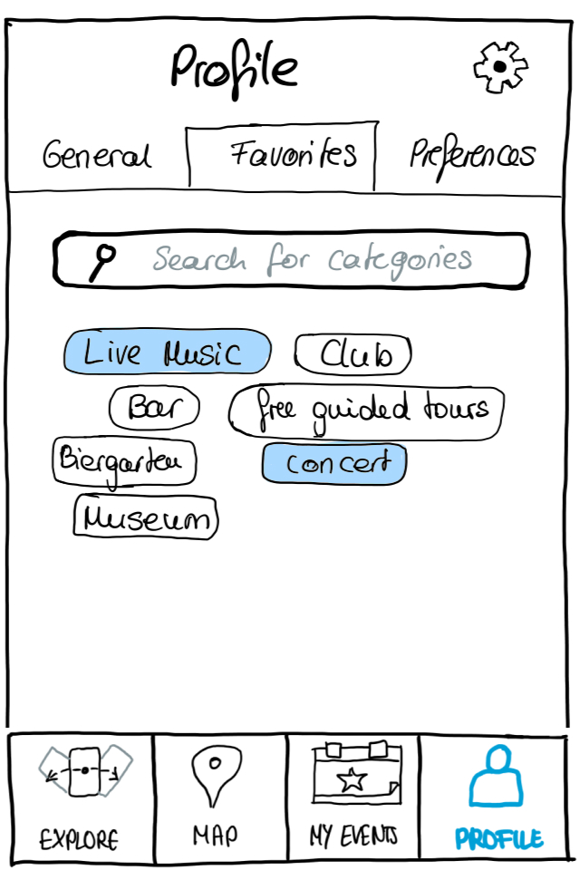
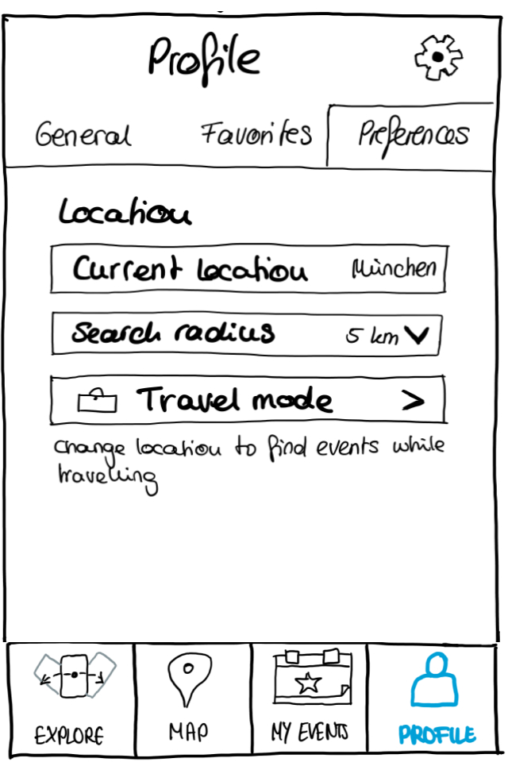
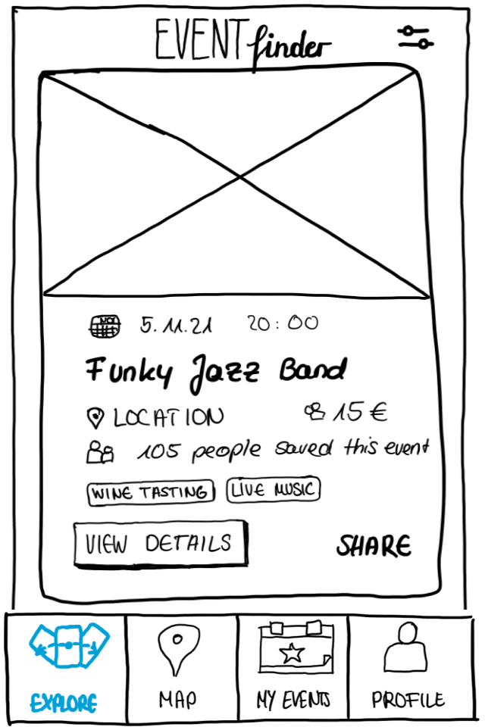
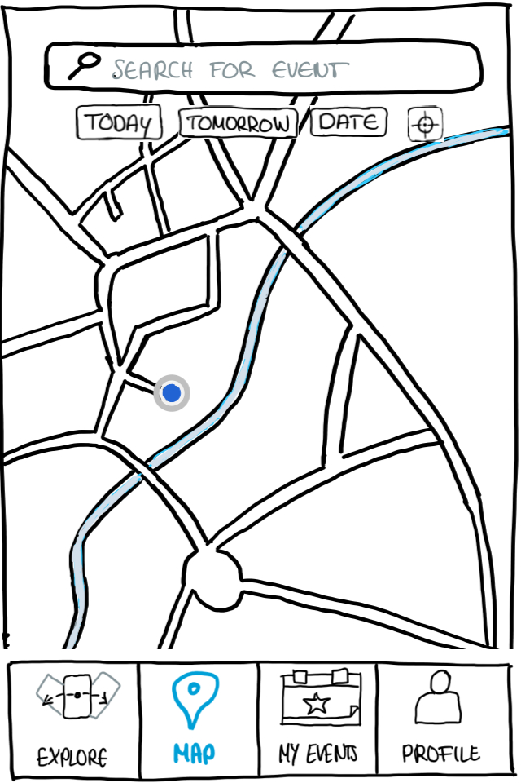
Lehrstuhl für Ergonomie TUM School of Engineering and Design Technical University of Munich
Reflection on Evaluation Results
FILTER FUNCTION
Flexibility and efficiency of use & Consistency
Personalization aspect must be improved (to many different places right now: 2x in settings + tabs)
Which effect do the user defined preferences have on the selection of suggested events?
Further issues
Add more filter options: time span, duration of events, etc.
?
Vincent Brunner | Beatrice Seibert | Stefano Ferrari| Interaction Prototyping| Winter Semester 2021/2022
9

Slide 11
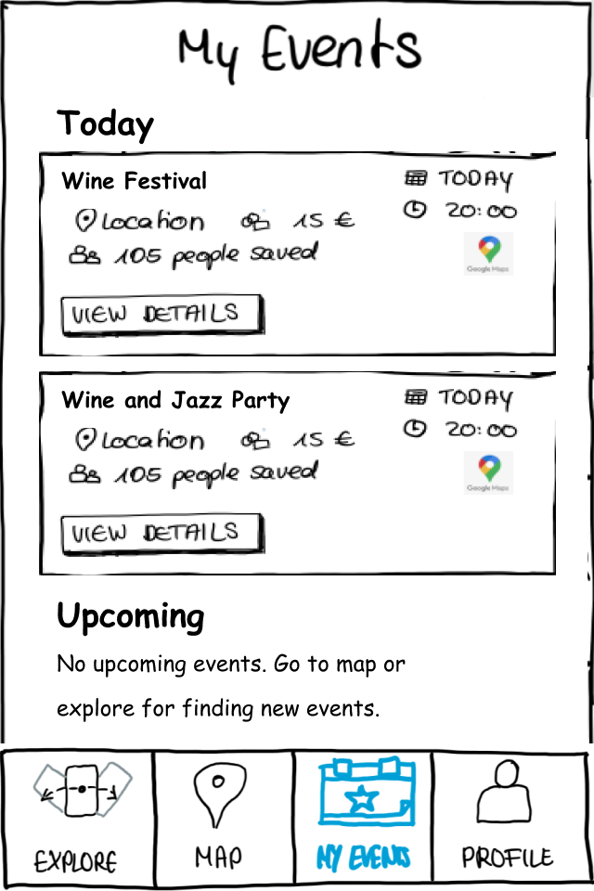
Lehrstuhl für Ergonomie TUM School of Engineering and Design Technical University of Munich
Reflection on Evaluation Results
Events View
User control and freedom & Help users recognize, diagnose, and recover from errors
Saved events cannot be deleted
User has no option to confirm event attendance (or canceling it)
Further issues
What happens to declined events? (→ Add area for decline events)
Add share button on overview page
Vincent Brunner | Beatrice Seibert | Stefano Ferrari| Interaction Prototyping| Winter Semester 2021/2022
10

Slide 12
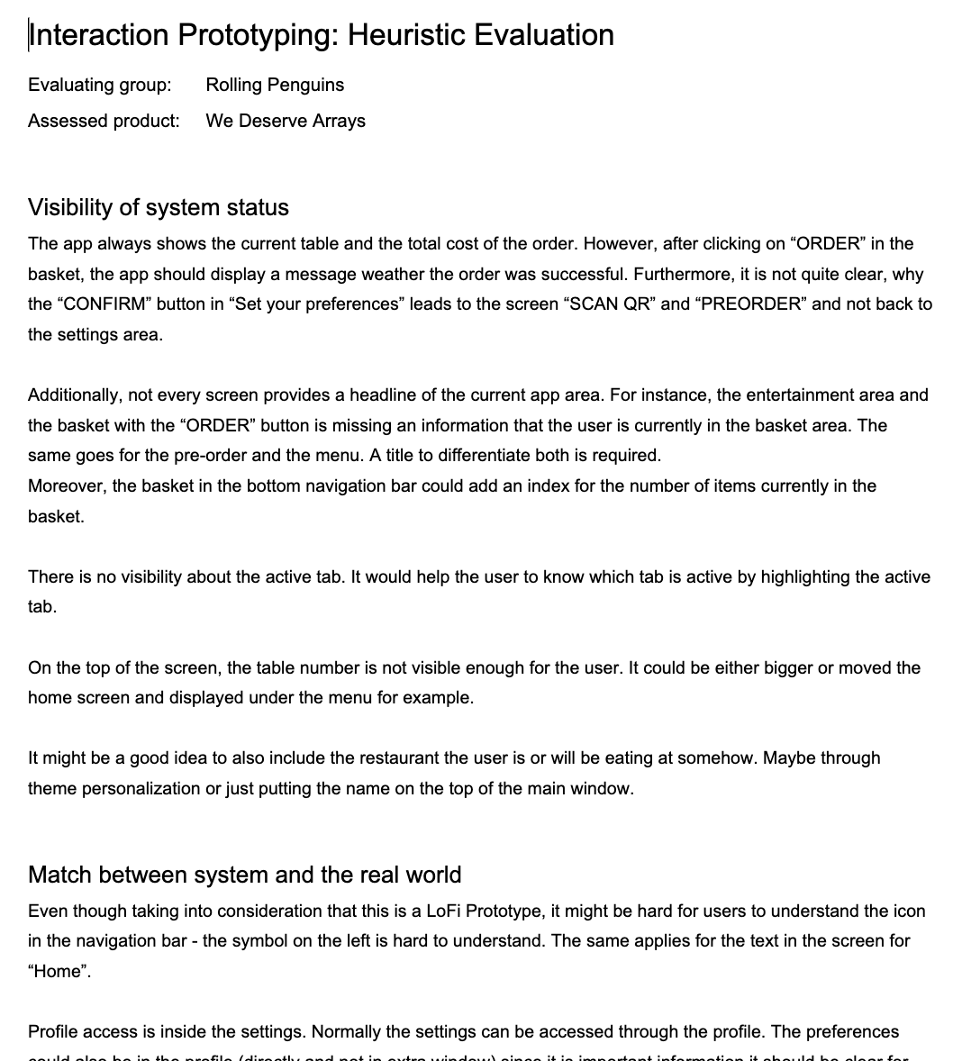
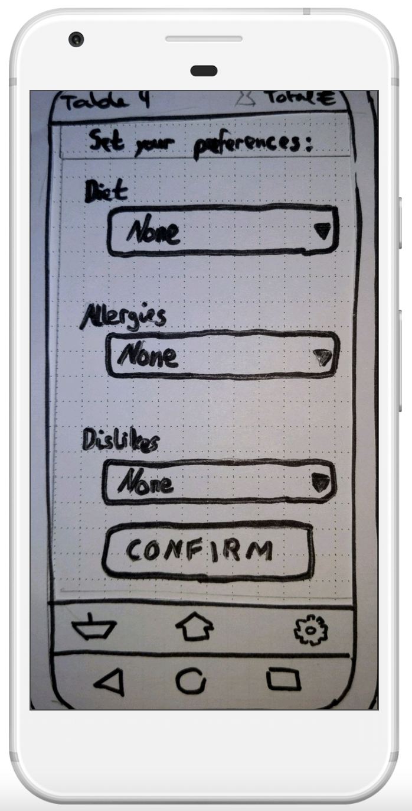
Lehrstuhl für Ergonomie TUM School of Engineering and Design Technical University of Munich
Heuristic Evaluation Approach
We deserve Arrays – Menu App
Heuristic by Heuristic evaluation the clickable Prototype
Vincent Brunner | Beatrice Seibert | Stefano Ferrari| Interaction Prototyping| Winter Semester 2021/2022
11

Slide 13
Lehrstuhl für Ergonomie TUM School of Engineering and Design Technical University of Munich
Heuristic Evaluation Approach
We deserve Arrays – "Bestellungen im Restaurant" -App
Examples:
Visibility of system status
There is no visibility about the active tab. It would help the user to know which tab is active by highlighting the active tab.
Error prevention
Maybe a text like “Basket” together with the navigation icons would help to prevent errors as users might not understand the icons and their function clearly
Heuristic by Heuristic evaluation the clickable Prototype
Vincent Brunner | Beatrice Seibert | Stefano Ferrari| Interaction Prototyping| Winter Semester 2021/2022
12

Slide 14

Lehrstuhl für Ergonomie TUM School of Engineering and Design Technical University of Munich
Thank you for your attention!
… any questions?
Vincent Brunner | Beatrice Seibert | Stefano Ferrari| Interaction Prototyping| Winter Semester 2021/2022
13

Slide 15
Lehrstuhl für Ergonomie TUM School of Engineering and Design Technical University of Munich
Literature
RUSSELL, N., W. M. P. V. D. AALST, A. H. M. T. HOFSTEDE AND P. WOHED 2006. On the suitability of UML 2.0 activity diagrams for business process modelling. In Proceedings of the Proceedings of the 3rd Asia-Pacific conference on Conceptual modelling - Volume 53, Hobart, Australia2006 Australian Computer Society, Inc., 95–104.
Vincent Brunner | Beatrice Seibert | Stefano Ferrari| Interaction Prototyping| Winter Semester 2021/2022
14

